Slide 1
CERN-KEK
X-band collaboration
3 Dec. 2011
T. Higo
on behalf of X-band group of KEK

Slide 2
Activities centered at CLIC high-gradient accelerator structures in 2011
Nextef runs for CLIC prototype evaluation
  T24 (undamped) was tested for 2000 hours till earthquake.
  TD24 (damped, CLIC prototype) is being tested now.
Role of magnetic field
  Became evident through the tests
Nextef is establishing a new test area for
  Basic studies to understand and suppress breakdowns
  Study toward much higher gradient
Production of test structures
  Two pairs of prototypes are being made in 2011
  Taking benefit from the collaboration with SLAC

Slide 3
High-gradient test at Nextef
2008 2009 2010 2011 2012
7 10 1 4 7 10 1 4 7 10 1 4 7 10 1 4 7 10
Nextef
KX03 (60cm HDDS)
T18_Disk_#2
TD18_Quad_#5
TD18_Disk_#2
T24_Disk_#3
TD24_Disk_#4
TD24R05?
TD24 Choke?
KT1
Narrow waveguide test
High power components test
RF delivery from KT1 to shield-B
Basic studies at shield-B

Slide 4
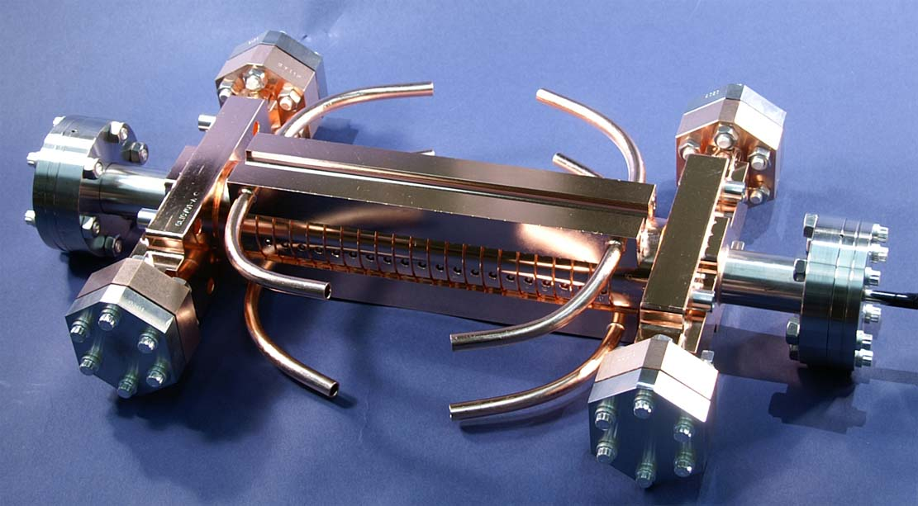
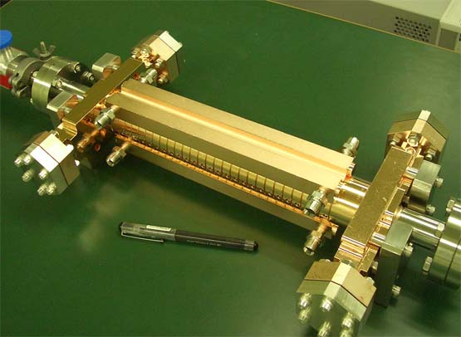


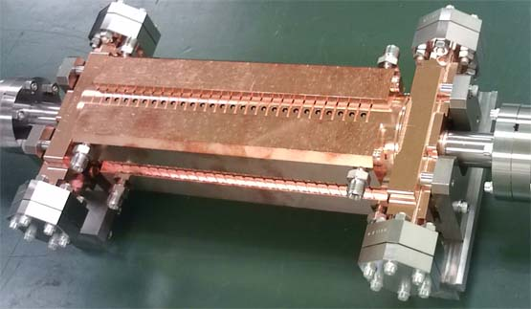
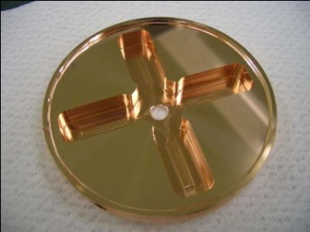
CLIC test structures; fabrication and test
T18 →TD18→T24→TD24
T18_Disk_#2
undamped
T24_Disk_#3
damped
TD18_Disk_#2
TD24_Disk_#4

Slide 5
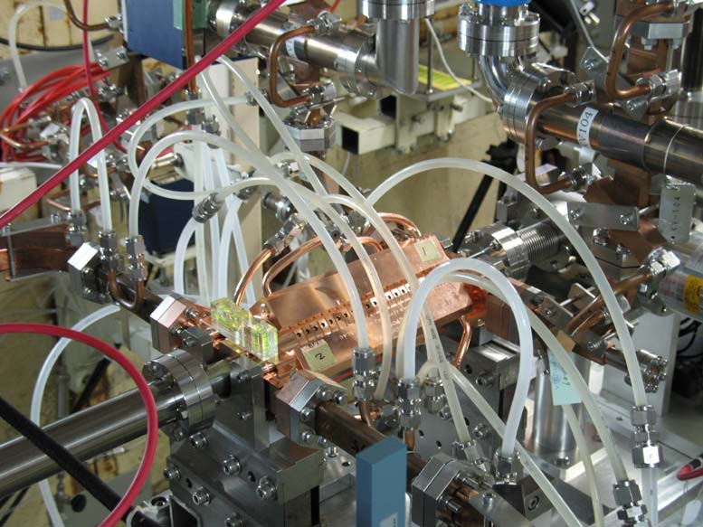
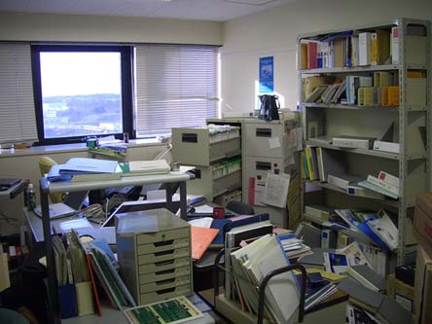
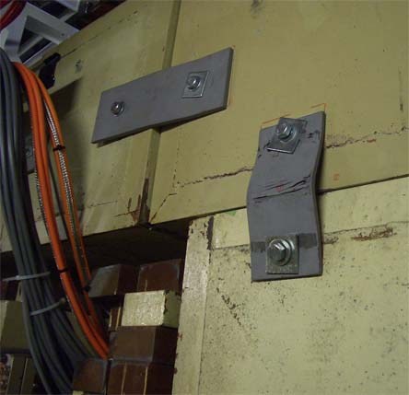
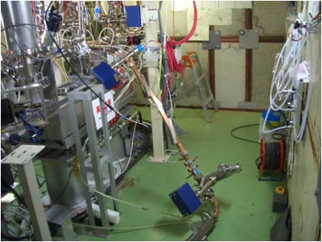
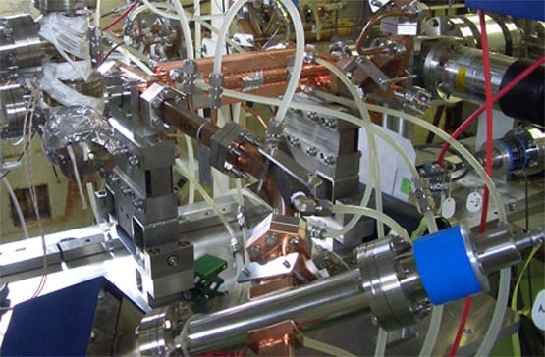
T24 run till earthquake and after
TD24 run
Our office
Nextef shield
But fortunately,
It reached the very promising breakdown rate, …..
Waveguide collapse
Exposed to air → finish

Slide 6
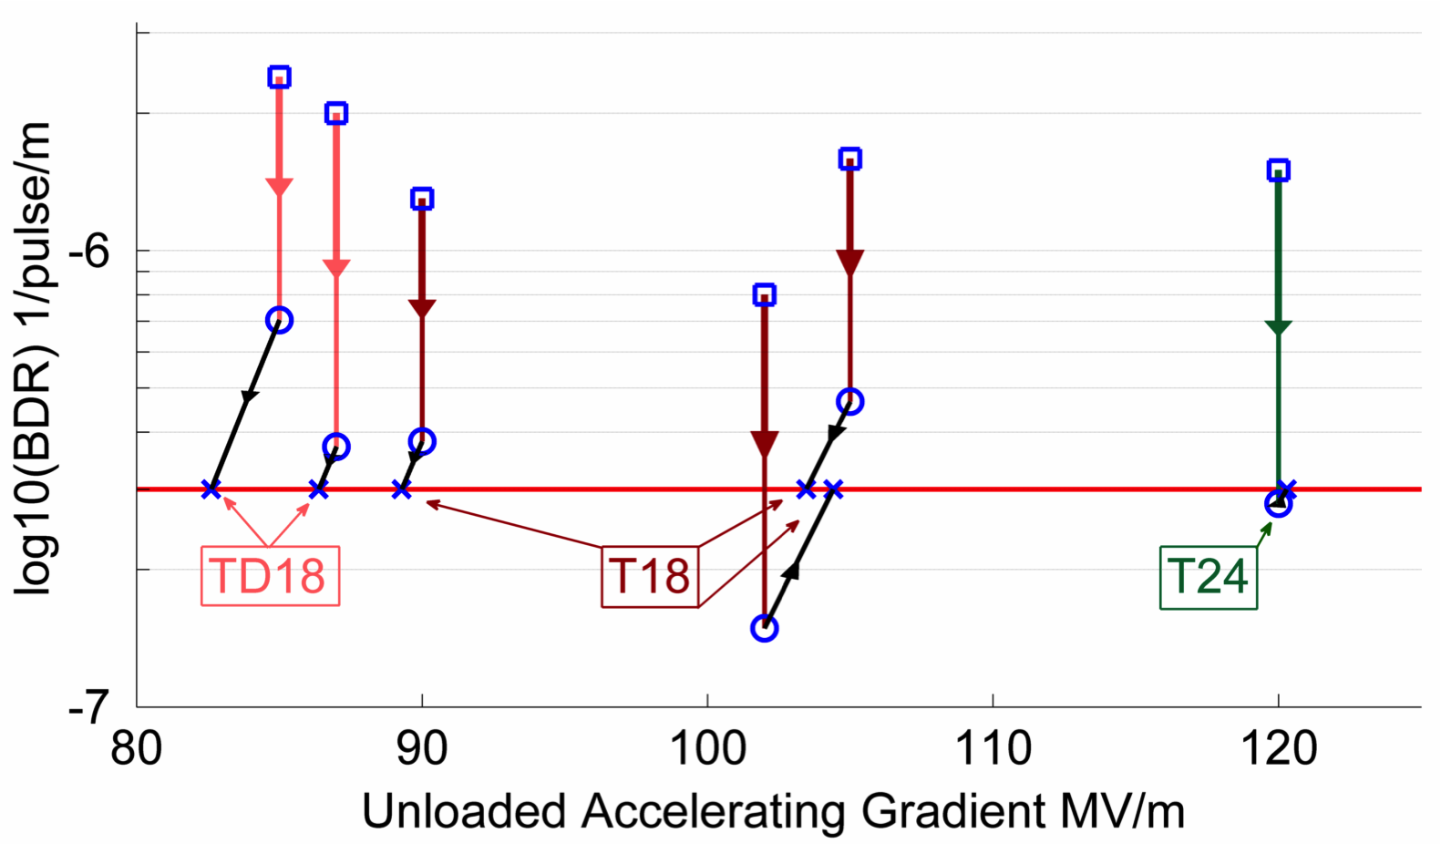
Achieved Gradient
Staphnes presentaion at LCWS11
Tests at KEK and SLAC
Measurements scaled according to:
Same input power as 100MV/m loaded
 | Simple early design to get started | More efficient fully optimised structure
No damping waveguides | T18 | T24
Damping waveguides | TD18 | TD24 = CLIC goal
CLIC RF team
N. Shipman
TD24: September 15th @ KEK
mid-November @ SLAC
Soon @ CERN

Slide 7
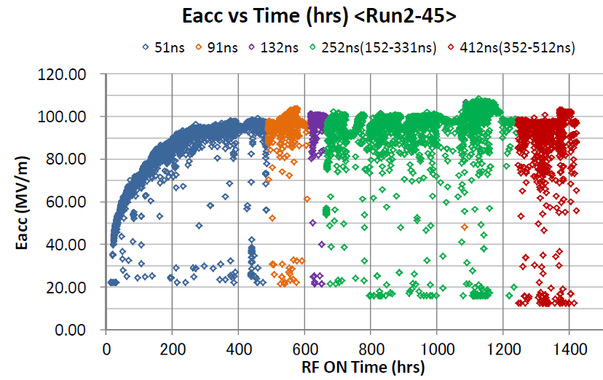
Toward evaluation of CLIC prototype
Damped TD24#4 processing for more than 1700 hrs on Dec. 3
Nov. 21

Slide 8
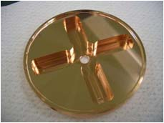
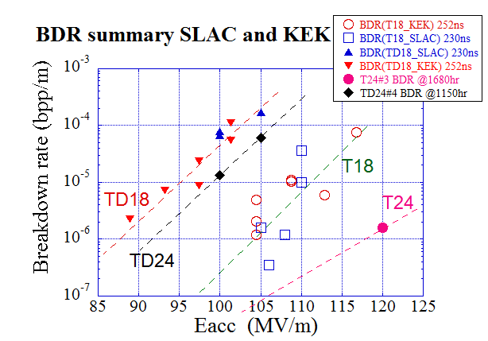
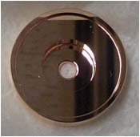
BDR comparison around 250ns
TD18#2@1600hrs
TD24@1150hr
TD24#4
on Dec. 3
at ~ 1700hr
preliminary
T18@2800hr
T24@1680hr

Slide 9
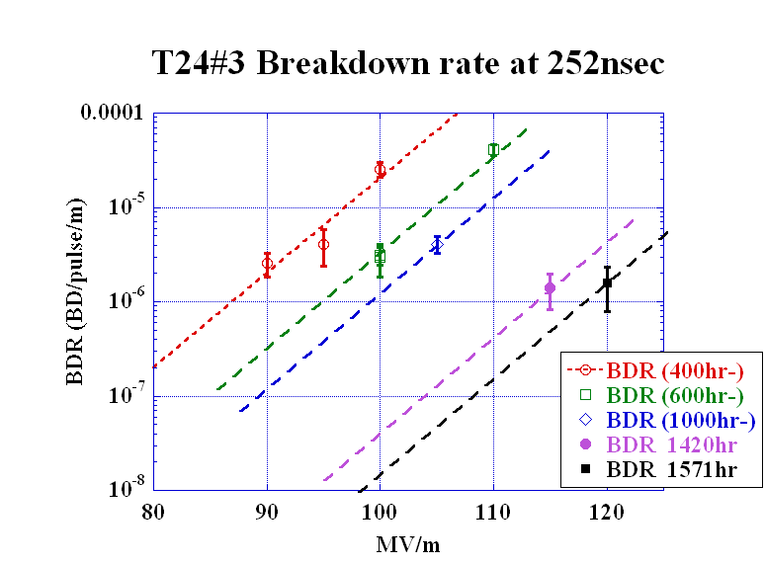
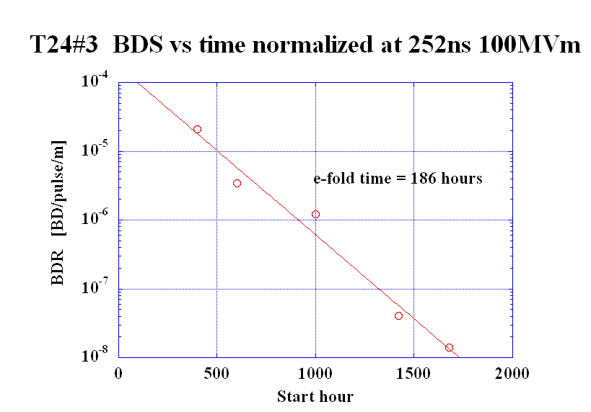
T24#3: Evolution of breakdown rate shows ever decreasing characteristics
We should and we can evaluate the same characteristics
in the CLIC prototype, damped structure, TD24#4.

Slide 10
Toward evaluation of TD24 in nominal CLIC operation
Damped structure
  TD24#4 (present one, close to CLIC)
100MV/m loaded
  100 MV/m no-loaded can only be estimated
CLIC pulse shape
  Nextef nominal test is severer in pulse shape, full square pulse of 252nsec
Processing continues, integrating more than 1700 hrs.
KEK and CERN agreed to evaluate the breakdown rate, close to CLIC requirement, through months of operation.

Slide 11
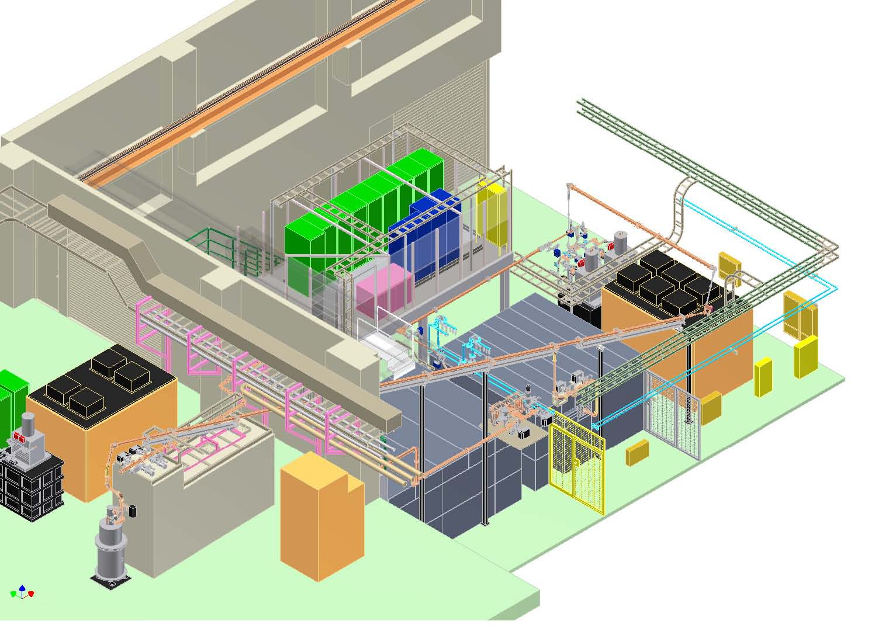
Nextef expansion for further strengthening the R&D
Nextef
X-band
KT-1
X-band
B
KT1-B
A
Pulse compressor
KT-2
C-band

Slide 12
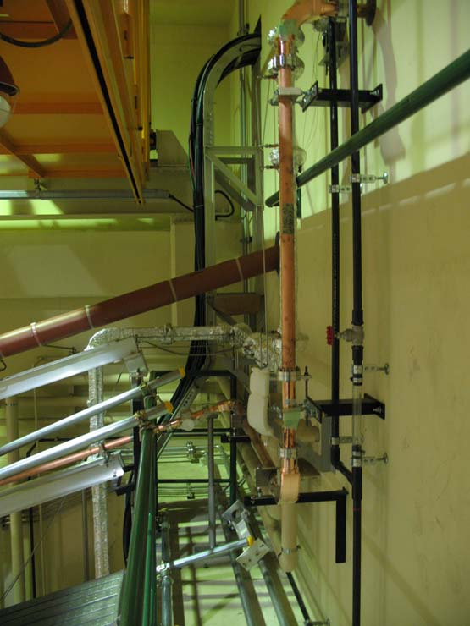
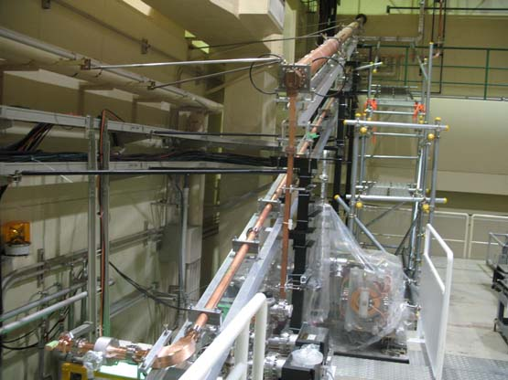
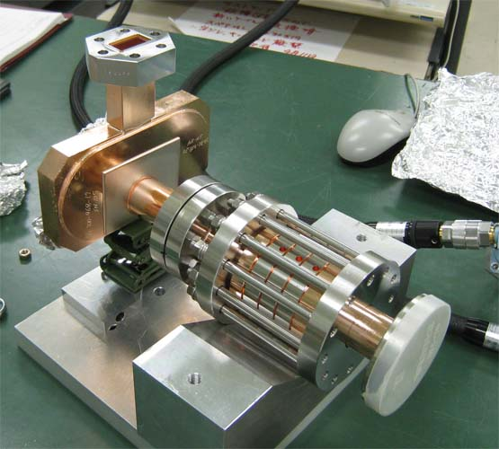
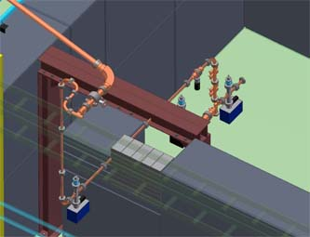
Commissioning of another test area, shield-B, is early next year
Single klystron
Transport line
Shield-B
Candidate of test setups being prepared at KEK

Slide 13
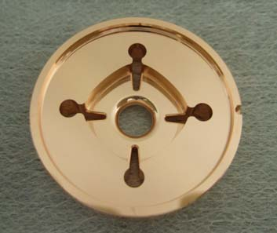
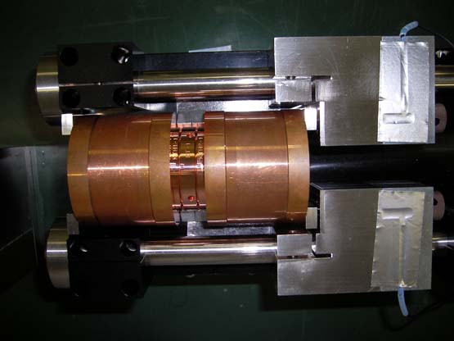
Other activities under collaboration
DDS
damped-detuned cells
Choke mode cavity
Program in collaboration with Tsinghua univ.
Assembly of whole structure by KEK to serve as an independent production study. We should revisit the fabrication study than that developed by SLAC/KEK.

Slide 14
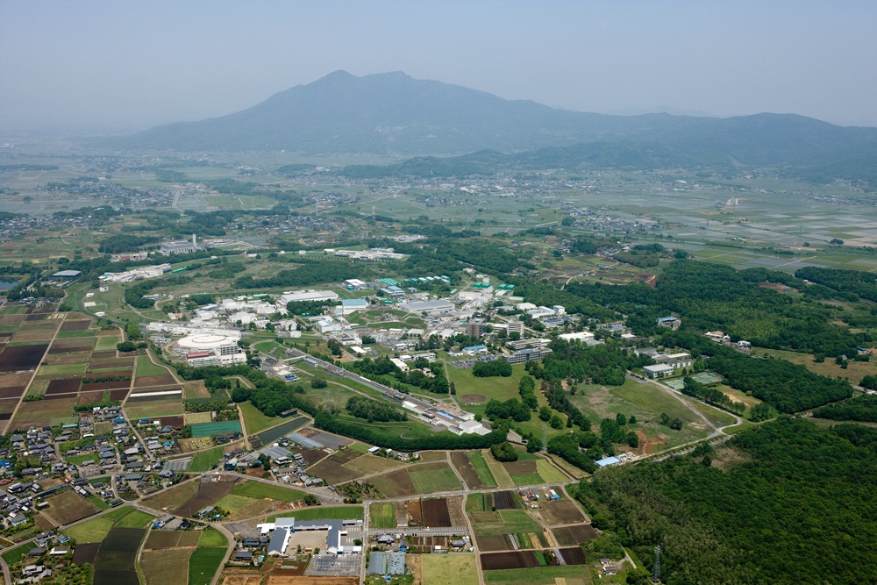
6th Annual Collaboration Meeting on X-band accelerator structure design and test program
International Workshop on
Breakdown Science and High Gradient Technology
Date: April 18th to 20th , 2012
Place: Seminar hall of 4th building, KEK, Tsukuba, Japan
Chaired by T. Higo (KEK).
Scientific program by T.Higo(KEK) S.Tantawi(SLAC) W. Wuensch(CERN).
Next collaboration meeting in next April,
a high gradient workshop, will be held in KEK.

Slide 15
CERN/KEK collaboration is a base for worldwide R&D toward high gradient
Asian collaboration
KEK
Structure fabrication & test @Nextef
Tsinghua, IHEP
Structure design, fabrication & test
US-Japan
SLAC/KEK
CERN/KEK collaboration
US-HG
CLIC
SLAC conducts structure fabrication, high power test & basic research
CERN supports for structure fabrication, high power test & system expansion
Notes:
日米協力 SLAC・KEK 1990年代～
2006年～ CERN Xバンド高電界開発 関わる ＆ 共同研究体制 構築された
最近では、アジアのラボを含めた共同研究を開始
日米での共同研究はその基礎技術を提供
SLAK/KEKの設備、人材、経験 を有効に使って開発発展させることが 今後の展開のキーになっている

Slide 16
Conclusion
KEK appreciates the study toward CLIC high gradient accelerator structure.
It gives KEK the important understanding and technology toward normal-conducting high-gradient operation.
On the other hand, KEK believes that the study offers CLIC an important standpoint.
Both CERN and KEK obtain mutual benefit from this collaboration.

